Slide 1
Understanding the Power Curve Interpolation Issue
Power Curve Working Group, 2016-03-10, Hamburg
Axel Albers

Slide 2
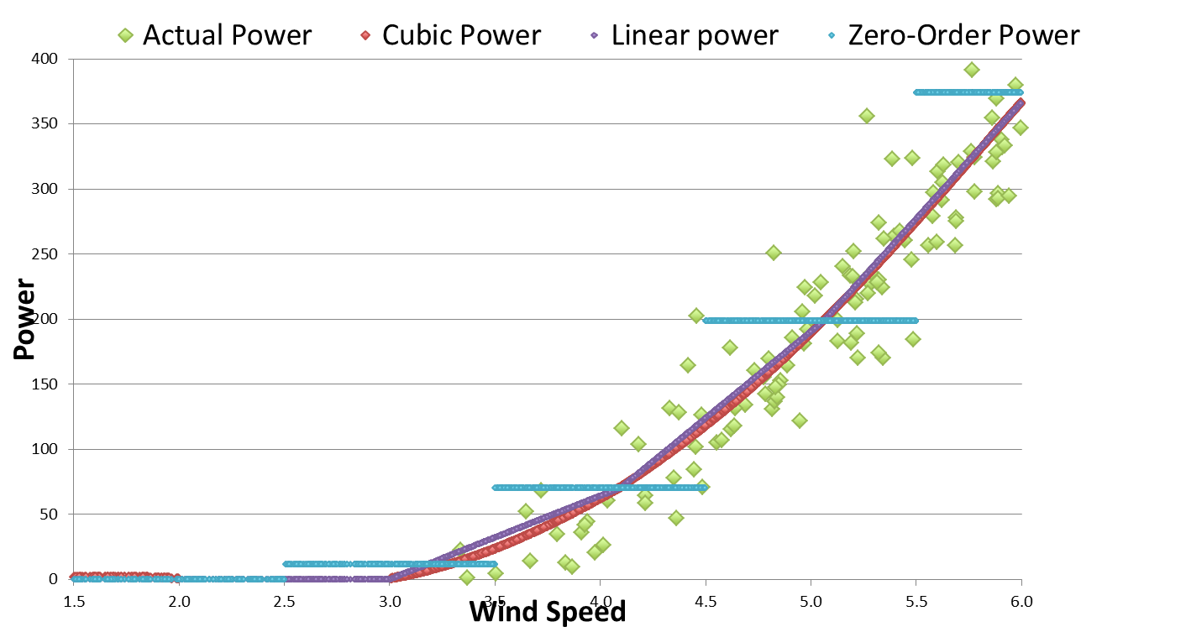
Illustration of Interpolation Problem
Source: P. Stuart, PCWG meeting London Dec. 2015
Power curve raw data P_{Actual}(t) is first bin-averaged (baseline power curve in inner range)
Bin averages are interpolated in order to derive power from bin-averaged power curve for actual wind speed: P_{Baseline}(t) or P_{Candidate}(t)

Slide 3
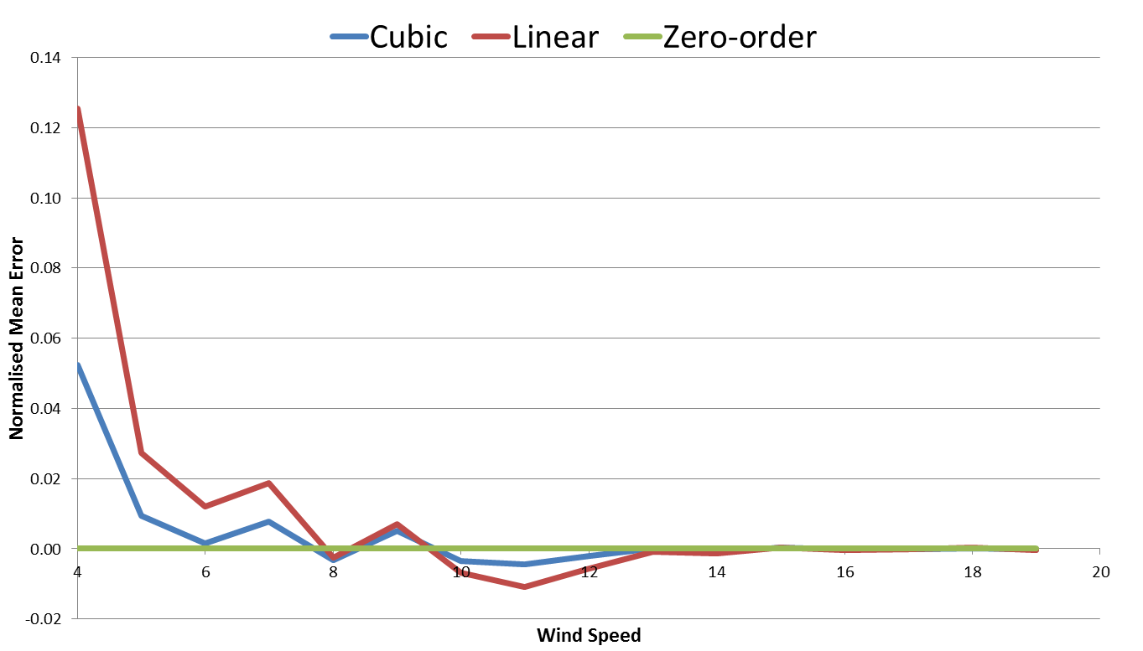
Inner Range Baseline Error
Source: P. Stuart, PCWG meeting London Dec. 2015
If NME is calculated for the inner range, it is expected to be zero (inner range baseline error)
But it isn’t: NME positive where power curve left-curved and negative where power curve right-curved

Slide 4
Explanation of Interpolation Error
The cause of the non-zero inner baseline error is the difference of the bin average of the power curve raw data and the bin average of the interpolated data
The cause is not the lack of representation of the raw data by the bin averages (as illustrated in last meeting)

Slide 5
Simulation of Effect
P_{Actual}(t): cubic increase of P with wind speed, c_{p}=0.45, cut-in wind speed of 3m/s, 50 (100) values per 0.5m/s (1.0m/s) wide bin, equally distributed

Slide 6
Simulation of Effect for 0.5m/s wide bins
Simulated inner range baseline NME significant at low wind speeds

Slide 7
Simulation of Effect for 1.0m/s wide bins
Inner range baseline NME significantly increased compared to 0.5m/s bins

Slide 8
Solution 1 to Overcome Effect (sophisticated)
Treat P_{Actual} in the same way as P_{Baseline} and P_{Candidate}:
- First bin-average P_{Actual}(t):
- Then interpolate bin averages according to actual wind speed: P_{Actual,interpolated}(t)
Calculate NME as:
The inner range baseline error is then zero by definition
The interpolation effect cancels out in ε_{Candidate} or ε_{Baseline} (outer range) as P_{Actual,interpolated}(t) undergoes the same interpolation as P_{Candidate}(t) or P_{Baseline}(t) (outer range)

Slide 9
Solution 2 to Overcome Effect (simple)
Problem in case of linear interpolation between bin averages: two line assumptions with two slopes in each bin
Solution: use only one line per bin, which passes through bin average,
Model in bin i:
Only issue: The model reproduces the exact bin average only if the wind speed is evenly distributed over the wind speed within the bin (is mostly the case).

Slide 10
Time Series Approach for Wind Resource Assessment?
The interpolation problem is fully present if a bin-averaged power curve is used to simulate the power output based on a time series of the wind speed (overestimation of power at ankle of power curve, underestimation at knee)
No error occurs when using a bin-averaged power curve in combination with a frequency distribution of the wind speed for the calculation of the energy production
Consequence: The candidate methods may better be used only to transform the inner range power curve to the bin average of the meteorological variables (e.g. turbulence, shear) as present in the outer range. Alternative: The inner range power curve is transformed to different target values of the meteorological variables. The respective power curves in the outer range are then weighted by the frequency of each target value.

Slide 11
First 4 Round Robin Tests of PCWG
The former round robin tests of the PCWG are not affected by the interpolation problem:
- no power measurement was used
- P_{Actual}(t) has been interpolated from a binned power curve
- P_{Candiate}(t) has been calculated based on P_{Actual}(t)
- As P_{Candiate}(t) and P_{Actual}(t) are affected in the same way by the interpolation, the effect cancels out in the comparison.

Slide 12
Interpolation Effect was Present also at Relative Power Curve Analysis
Original Self-Consistency Test in Training Period
Improved Self-Consistency Test in Training Period
Approach of equal treatment of power curves helped to improve self-consistency test of Relative Power Curve Analysis

Slide 13
Thank you
contact: a.albers@windguard.de

